Slide 1
DTC Road Transport Network
Analysis using SNA Techniques
Parveen Bajaj, EET182574
Abhishek Bohra, EET182561

Slide 2
Problem Definition
To analyze Delhi Bus Route Network using Social Network Analysis techniques.
Why Bus Route and Why Delhi?
What will we deliver ?
Systematic survey of Delhi Transport Network.
Present a model that with a small number of simple rules would be capable to reproduce the main properties.

Slide 3
Tasks
Systematic Collection of Bus Routes and Bus Stops data
Perform Social Network Analysis Techniques
Modeling of Bus Route Network into following Topologies
L , B, C and P Space Topologies
Degree Distributions and Centrality of Nodes along with their significance
Betweenness and Clustering Coefficents
Candidate Bus Routes for Expressway Corridors and Bus Rapid Transit Services
Diameter of Network
Applying Optimization techniques to improve the Network Efficiency.

Slide 4
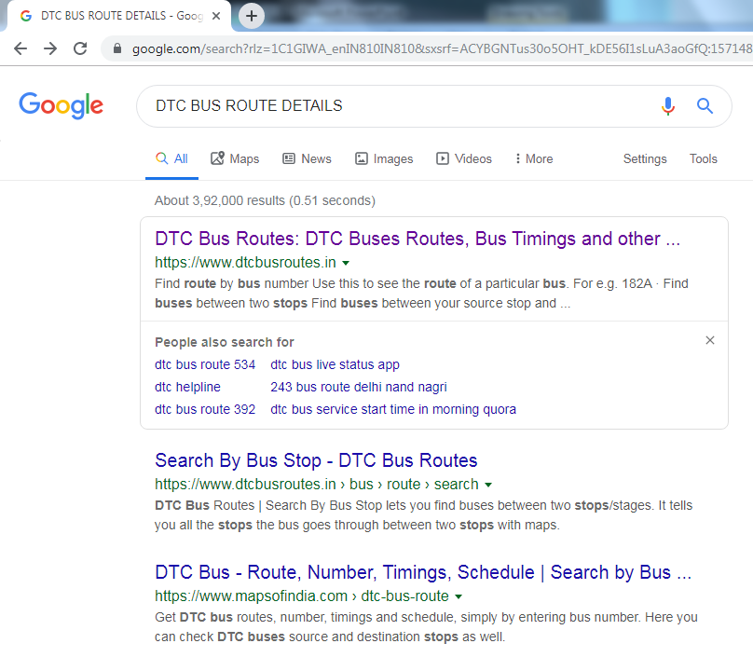
Collection of Data

Slide 5
Collection of Data

Slide 6
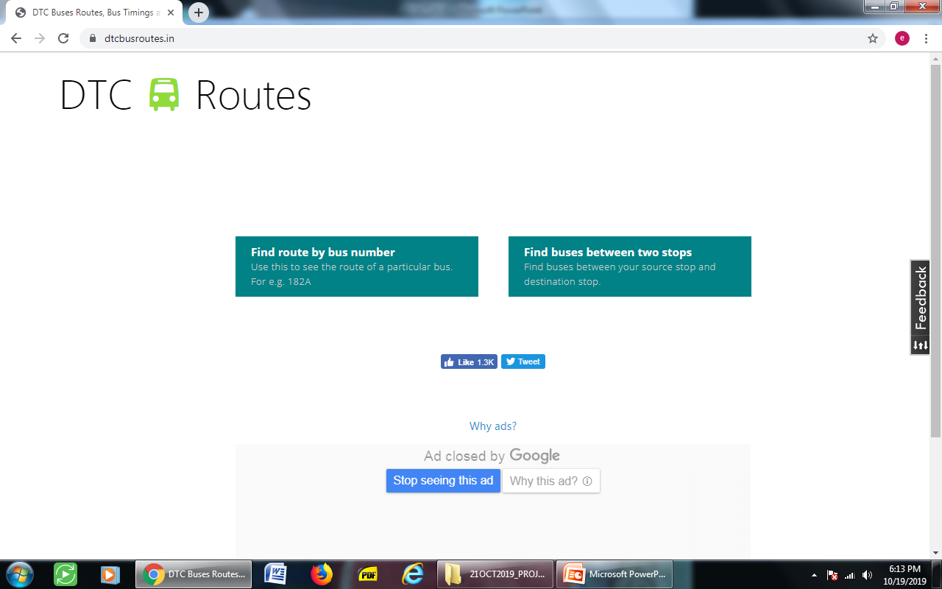
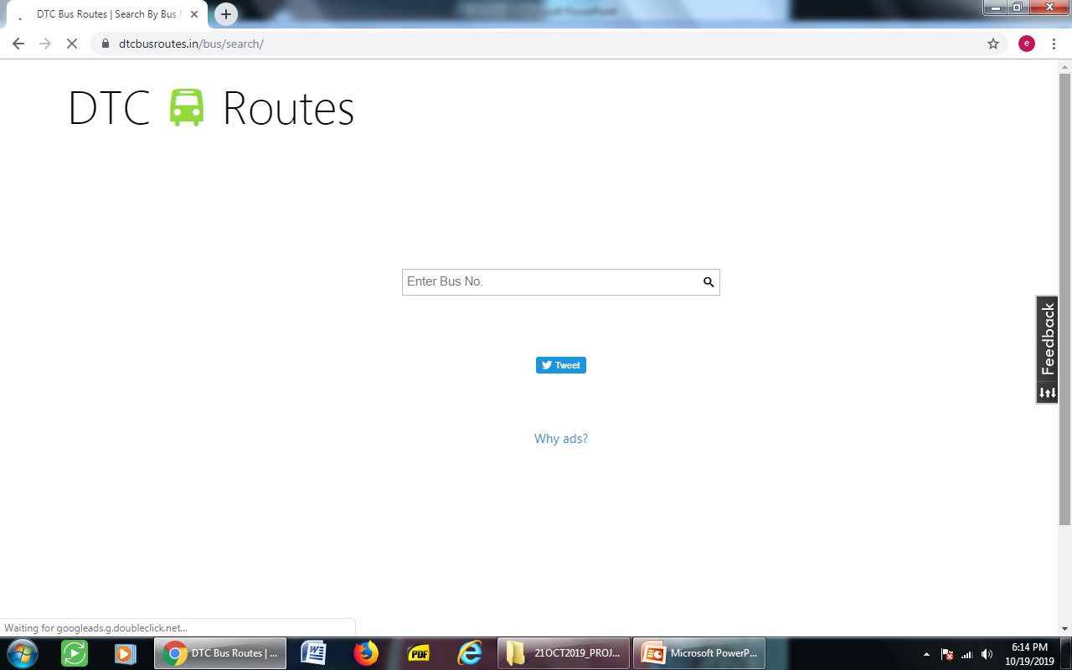
Collection of Data

Slide 7
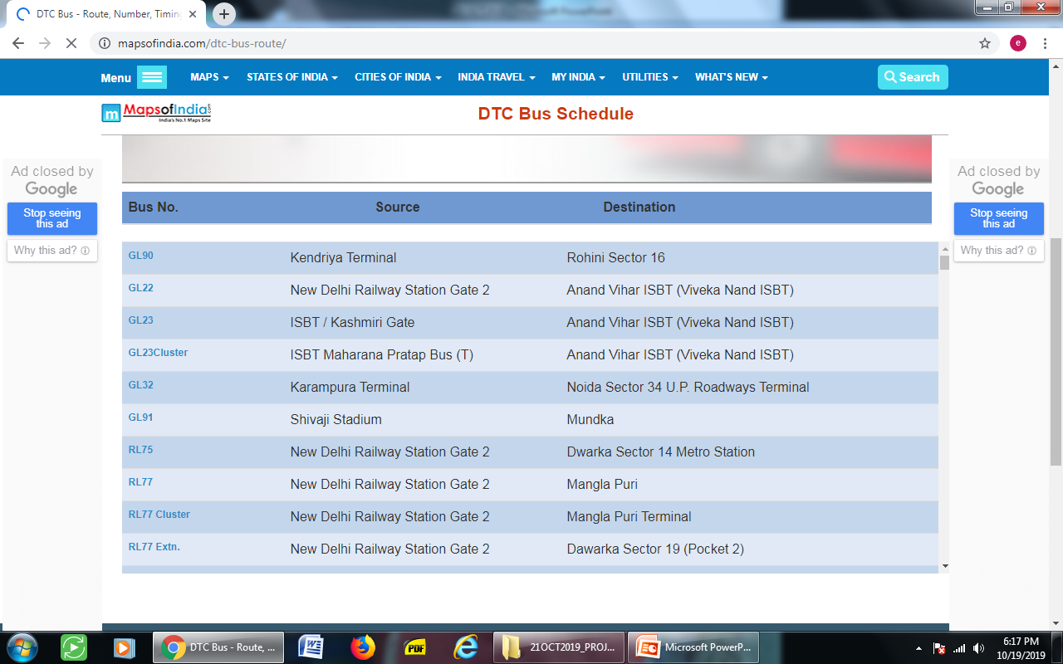
Collection of Data

Slide 8

Collection of Data

Slide 9
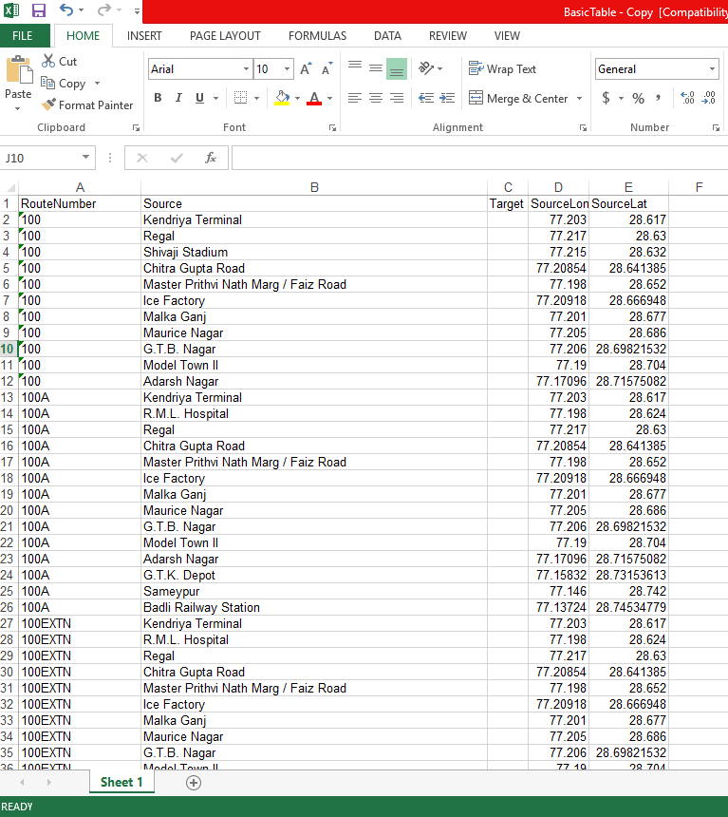
Collection of Data

Slide 10
Prepared L, C, B & L Space
L Space:
Nodes -> Bus Stop
Edges -> If nodes are adjacent.
B Space:
Two mode network (Bipartite Graph)
Bus Route and Bus Stops are nodes.
Each route node is linked to all stops that it serves
P Space:
Nodes are Bus Stops
Edge between bus stops if they are served by atleast one common route.
C Space:
Route nodes
Two routes are connected if they share a common station.

Slide 11
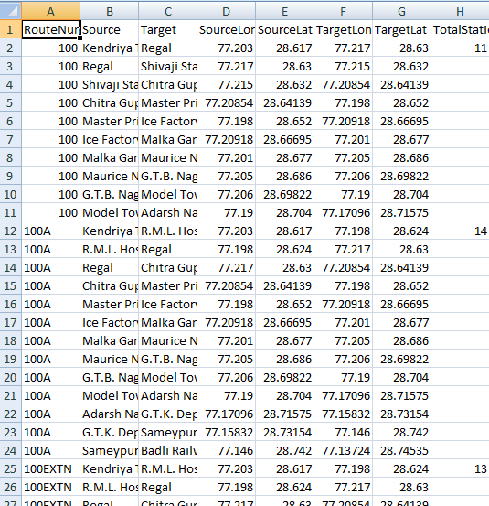
L-Space
Bus Routes - 737
Bus Stops - 1860

Slide 12
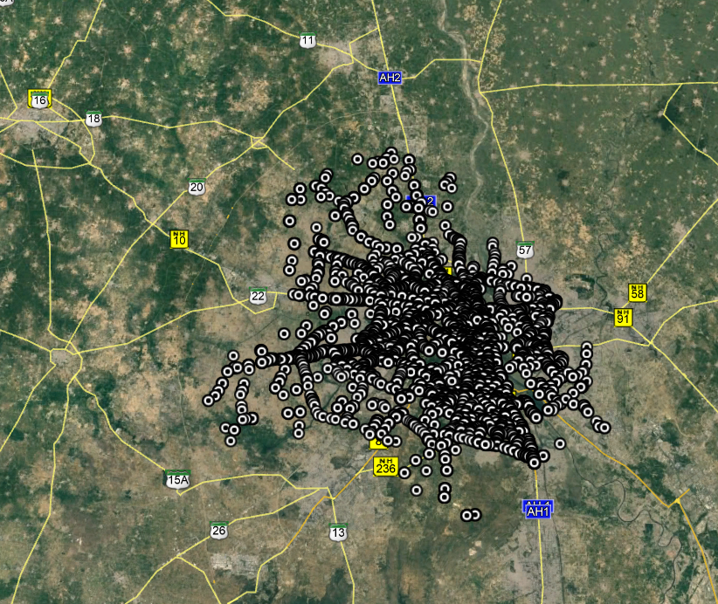
Google Earth View

Slide 13
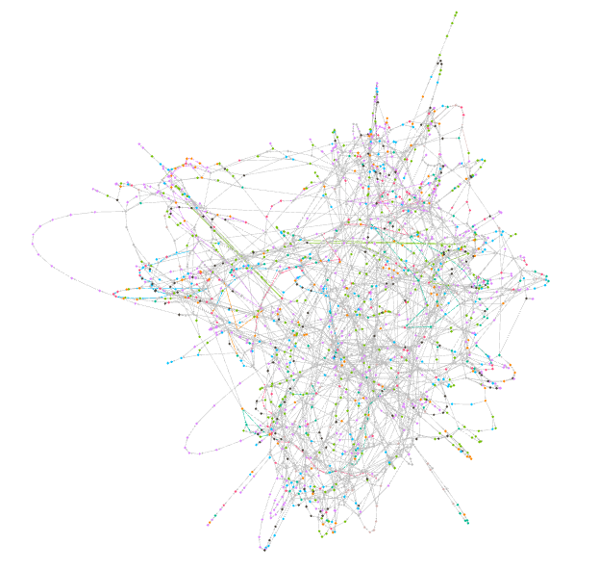
L-Space
Bus Routes - 737
Bus Stops - 1860

Slide 14
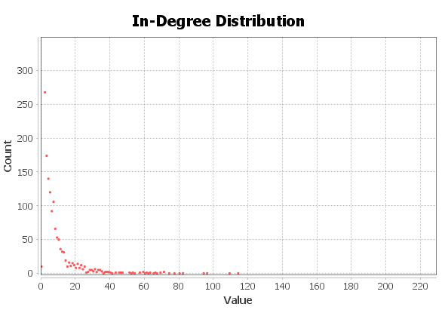
Degree Distribution L Space
A node havinh high degree in L Space simply means it is connected to more number of bus stops.
Potential candidate for Bus Depots or Hub

Slide 15
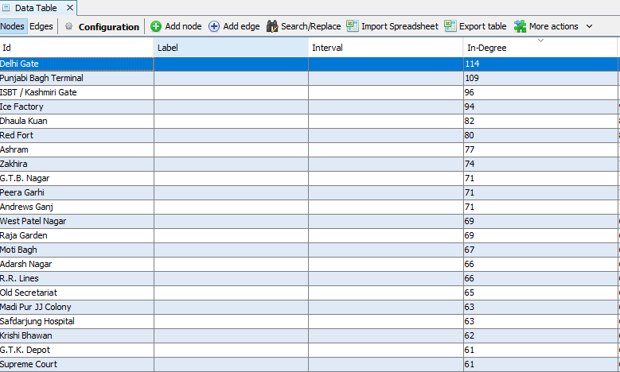
Degree Distribution L Space

Slide 16
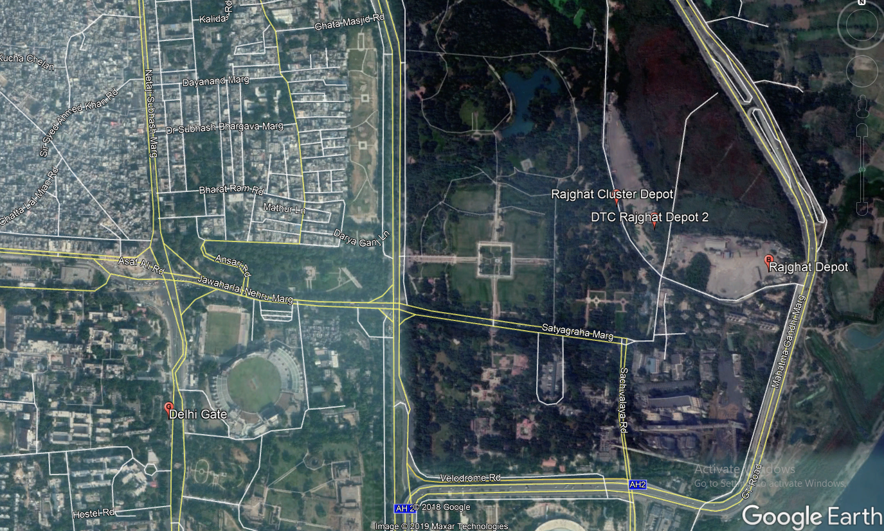
Potential candidate for Bus Depots or Hub

Slide 17
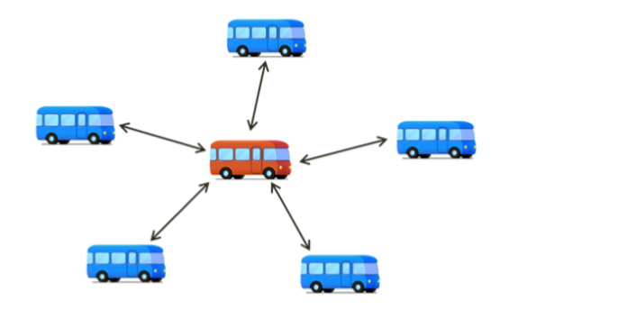
Identification of candidate Bus Routes for Expressway Corridors
Using C Spaces

Slide 18
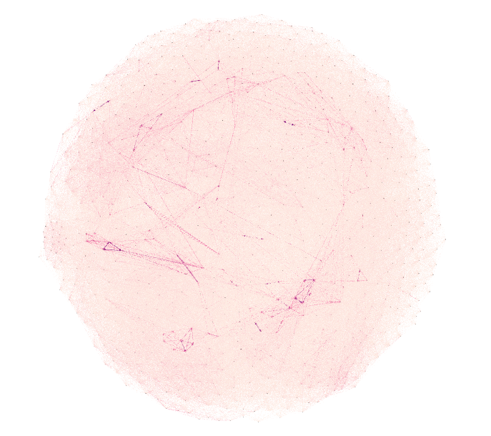
Plot of C Space in Gephi
Nodes:737
Edges: 159992

Slide 19
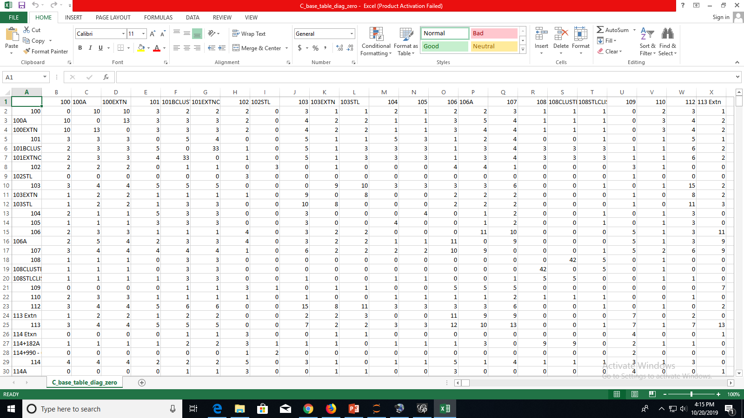
Preparation of C Space

Slide 20
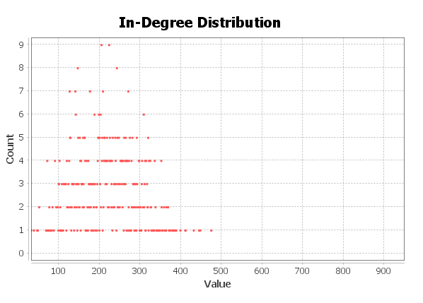
Identification of candidate Bus Routes for Expressway Corridors (How ???)

Slide 21
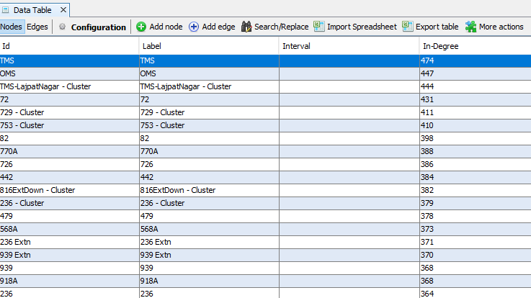
Identification of candidate Bus Routes for Expressway Corridors (How ???)
In C Space, nodes having high degree are best candidate for Expressway Corridors.

Slide 22
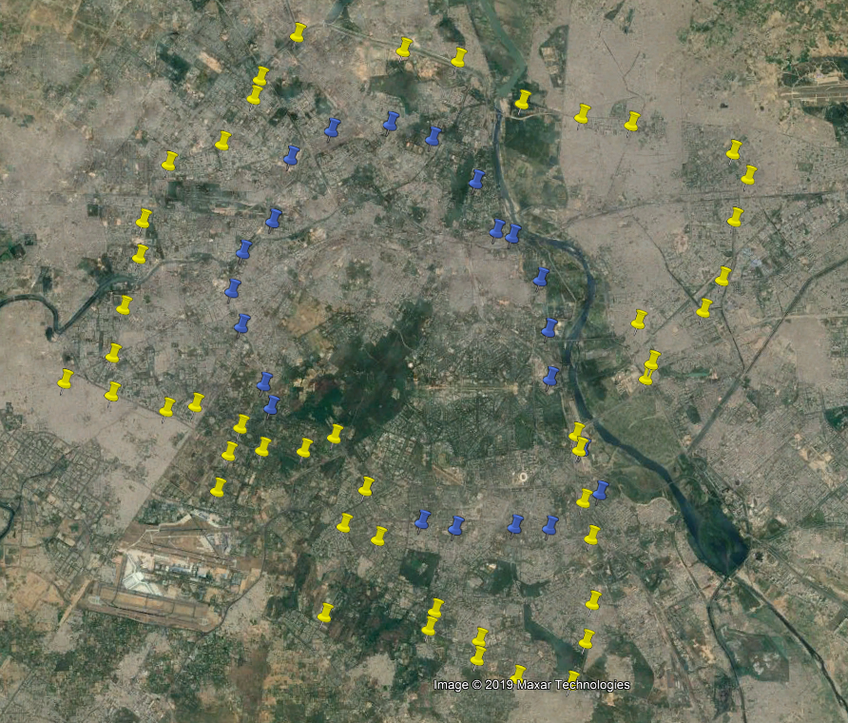
Candidate for Express Highway
TMS Bus Route
OMS Bus Route

Slide 23
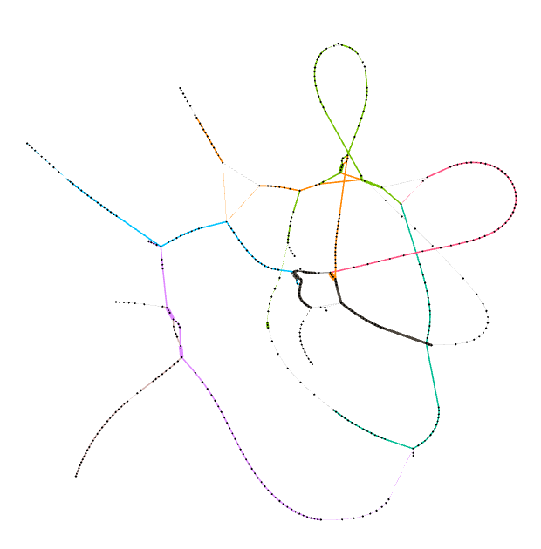

Identification of BRT Routes using Cs Networks
623 Extn: 56
623 Extn Cluster: 67
Cs 55
Cs 43

Slide 24
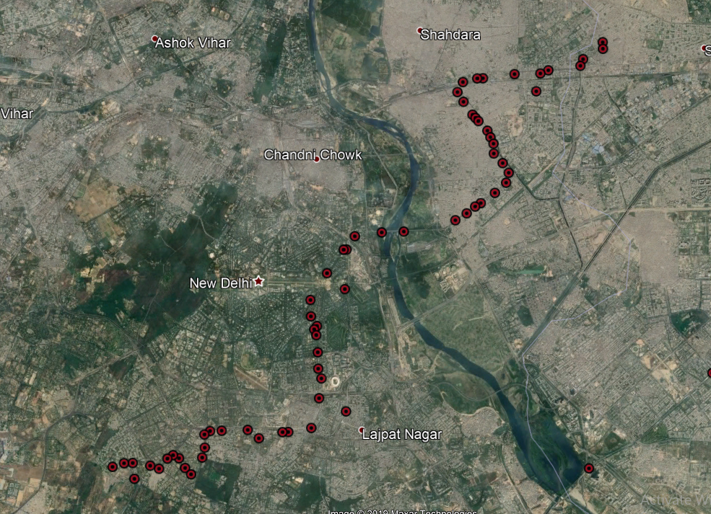
Cs 55 Results 623Extn Cluster

Slide 25
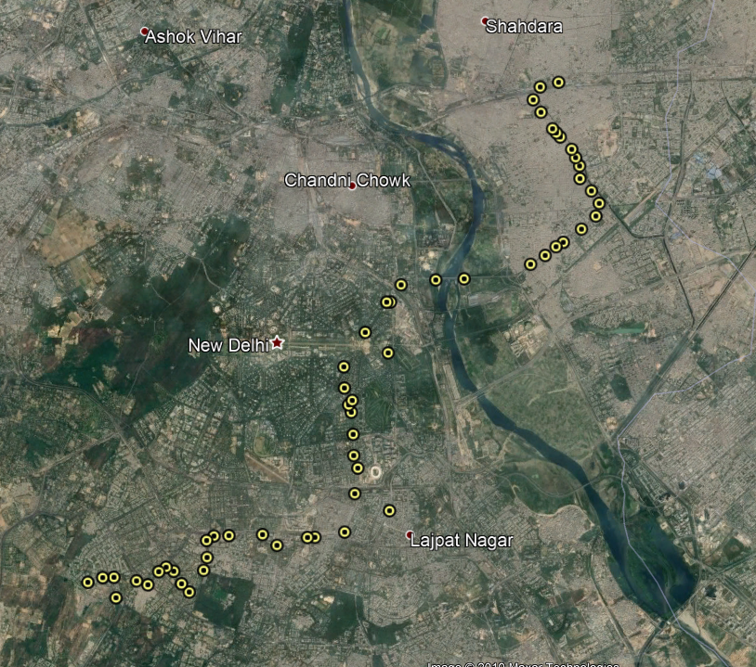
Cs 55 Results 623 Cluster

Slide 26
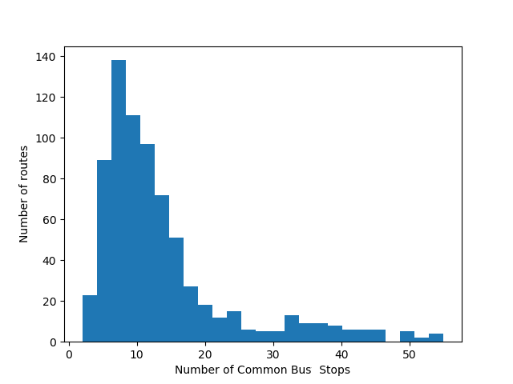
Histogram Plot of C Space

Slide 27

Identification of BRT Routes using Cs Networks
Bus Route | Number Of Bus Stops
623 Extn | 56
623 Extn Cluster | 67
764 Cluster | 54
764 Extn Cluster | 63
921 CL | 59
921E Cluster | 62
Cs 50

Slide 28
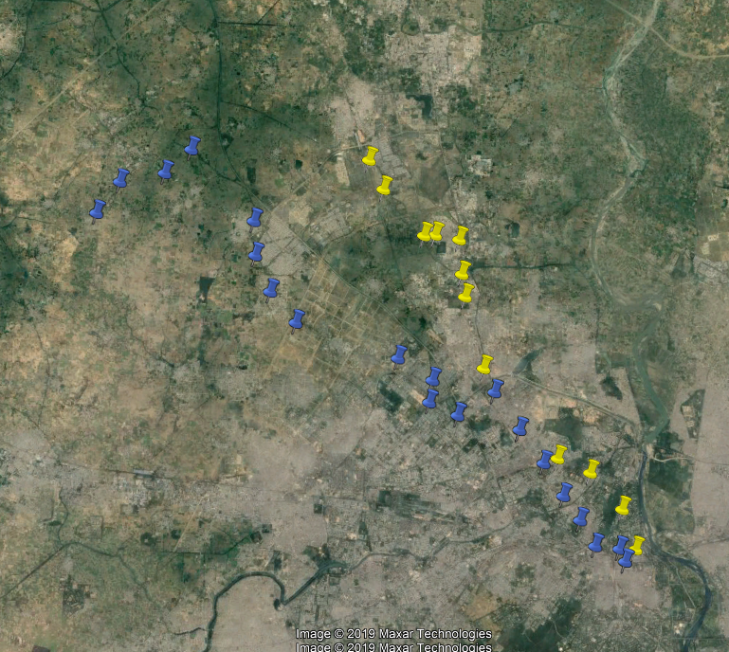
Near 215 degree bus routes

Slide 29
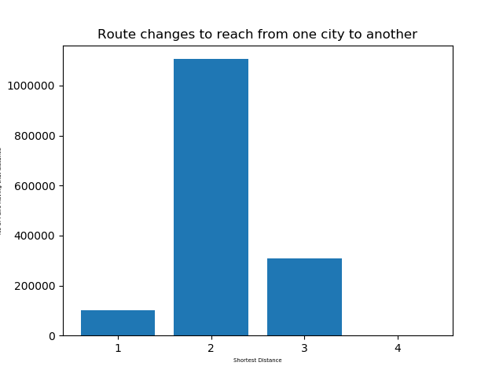
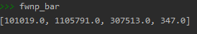

Slide 30
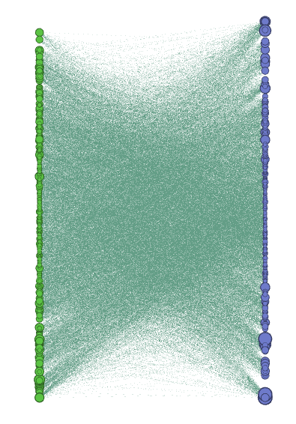
B-Space

Slide 31
Network Optimization
Weights: Bus Driving Efficiency
Optimize : Network Efficiency

Slide 32
Weigthed Bus Network
Previous Network
Weights: Either 0 or 1
Weighted Network
Important Factors
Distance
Road carrying capacity
Passenger load rate
Passenger Flow
Waiting Time of Passengers
Bus Driving Efficiency

Slide 33
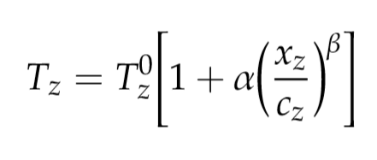
Road Impedance Function
Physical Quantity
Captures magnitude of resistance encountered by a vehicle on the road.
Vehicle Travel Time
Bureau Of Public Roads
Traffic flow of the
road section z
Actual capacity of
Section z
Impedance Value of
road section z when
traffic flow= 0
α = 0.15, β = 4

Slide 34
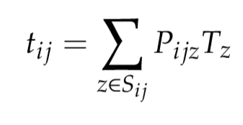
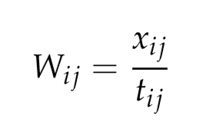
Bus Driving Efficiency
Bus Travel Time
between adjacent stations
Road Impedance
All sections of the road
Portion of total
distance of section z
Bus Driving Efficiency
between adjacent stations
Passenger flow between
station i and j

Slide 35
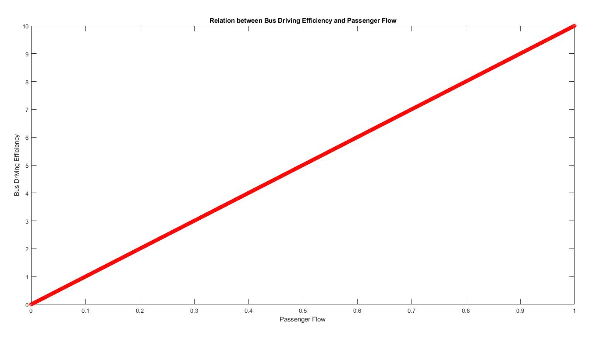
Bus Driving Efficiency

Slide 36
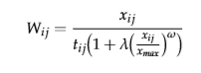
Improved Bus Driving Efficiency
Passenger waiting time depends on
Number of bus routes
Passenger flow xi,j
λ = 1; ω = 10

Slide 37
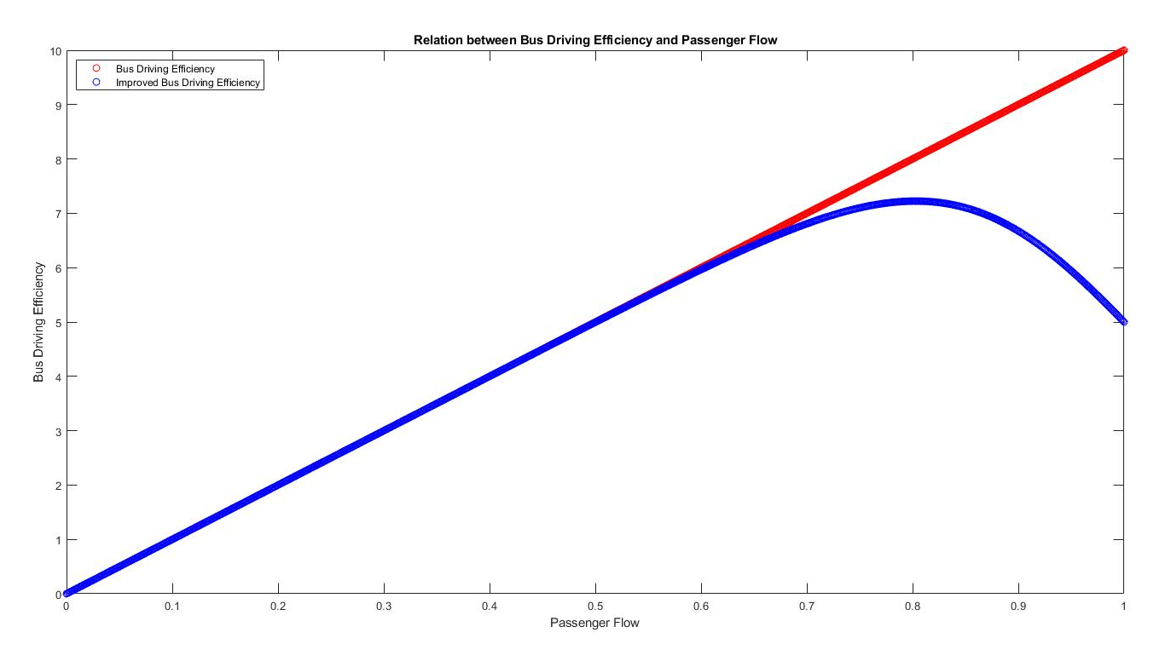
Improved Bus Driving Efficiency

Slide 38
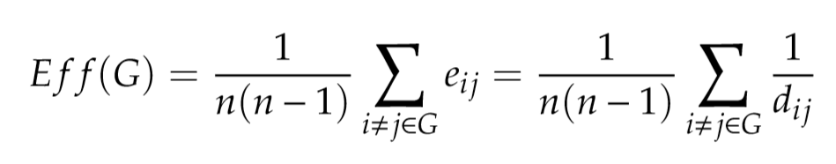
Network Efficiency Optimization
Static Bus Network Efficiency
Existing Data Static Bus Network Efficiency = 0.25 = 25 %

Slide 39
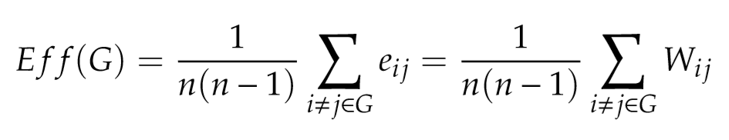
Improved Transit Network Efficiency Optimization

Slide 40
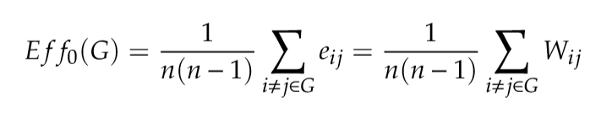
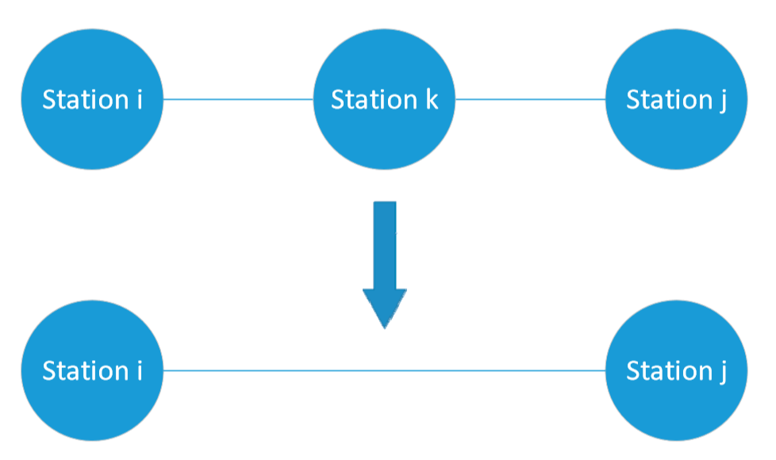
Improved Transit Network Efficiency Optimization Method
First Compute initial efficiency
Delete Bus Station

Slide 41
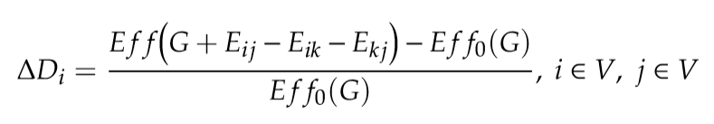
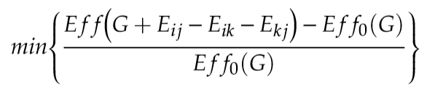
Improved Transit Network Efficiency Optimization Method
Recompute the Efficiecny

Slide 42
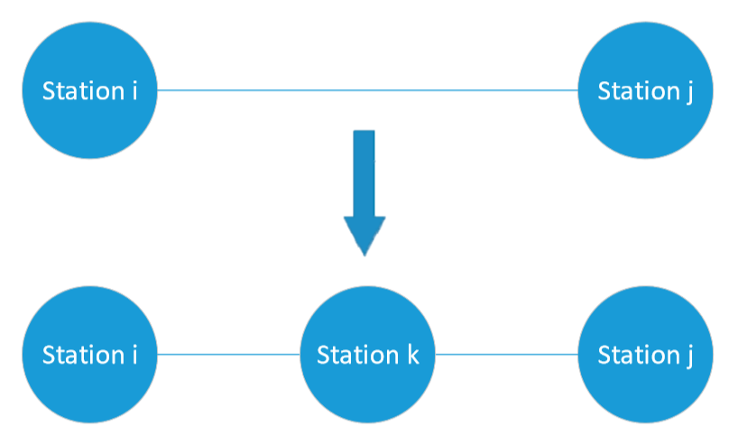
Improved Transit Network Efficiency Optimization Method
Add the Bus Stops

Slide 43
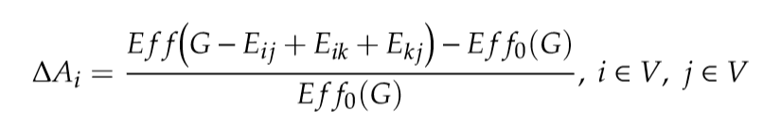
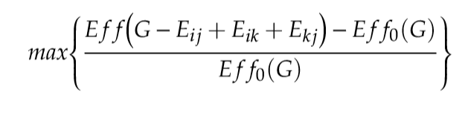
Improved Transit Network Efficiency Optimization Method
Add the Bus Stops

Slide 44
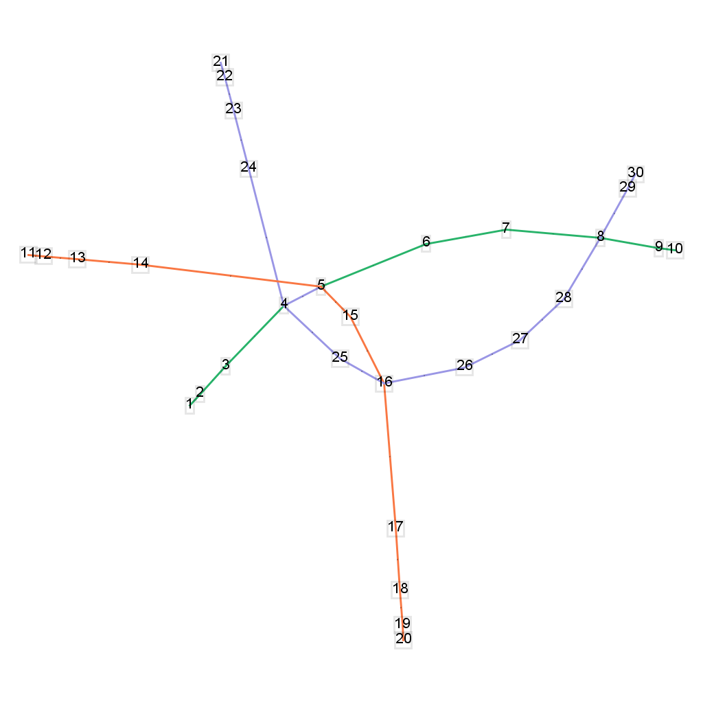

Slide 45
Simulation Results
Deletion of Nodes
Weights Sum Init | Efficency Init | Weights Sum- Node 13 del | Efficiency-Node 13 del | Weights Sum- Node 18 del | Efficiency-Node 18 del
315.1449 | 0.3622 | 315.1449 | 0.3881 | 315.1449 | 0.4169

Slide 46
Literature Survey
The Analysis of the Properties of Bus Network Topology in Beijing Basing on Complex Networks by Hui Zhang,1 Peng Zhao,1 Jian Gao,1 and Xiang-ming Yao1,2
Bus transport network analysis in Rio de Janeiro based on topological models using Social Networks by Diego Carvalho.
Study on some bus transport networks in China with considering spatial characteristics by Xu-Hua Yang a,⇑, Guang Chen a,b, Sheng-Yong Chen a, Wan-Liang Wanga, Lei Wang .
Structural Analysis of Bus Networks Using Indicators of Graph Theory and
Complex Network Theory by Hui Zhang.
Public transport networks: empirical analysis and modeling by C. von Ferber
A Method of Bus Network Optimization Based on Complex Network and Beidou Vehicle Location by Peixin Dong
Public Transport Networks: Empirical Analysis and Modeling by C. von Ferber

Slide 47
Thank You

Slide 48
How Many Bus Routes & Bus Stops?
Bus Routes
From Bipartite Graph (B-Space),
Number of Nodes in Bus Routes or Out Degree Nodes
From C Space,
Number of Nodes
Bus Stops
From Bipartite Graph (B-Space),
Number of Nodes in Bus Stops set or In Degree Nodes
From C Space,
Number of Nodes

Slide 49
Outcomes
How many routes?
How many Bus stops?
Identification of candidate Bus Routes for expressway corridors
Identification of candidate Bus Routes for BRT Service
Bus Depot / Hub Locations
How many bus routes are needed to get from one bus stop to another?
How many maximum routes will we require to move between the two most distant bus stops within the city?
Avg Number of Bus Stops per route.
How many bus stops a person can go by using only one line?
How many bus routes are required to reach 99 % of Bus Stops?

Slide 50
Thank You

